Slide 1
Shell Bootcamp 2024 3 Reflections for Week #<>
Sajja Saathvik Choudhary
Date : 30-Aug-2024

Slide 2
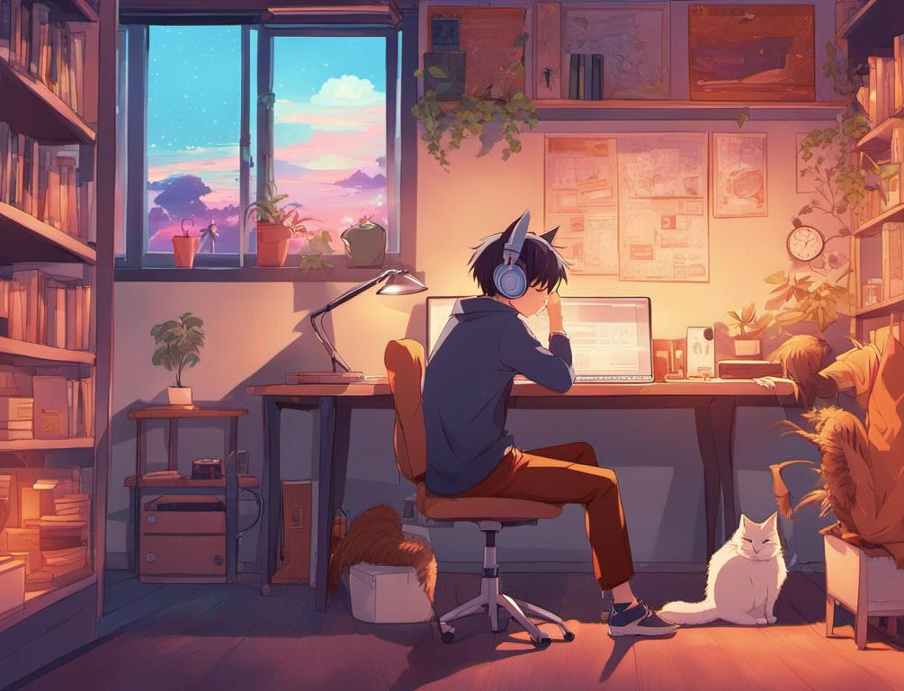
About Me
The harder you work the luckier you get.

Slide 3

My learnings from this week!

Slide 4
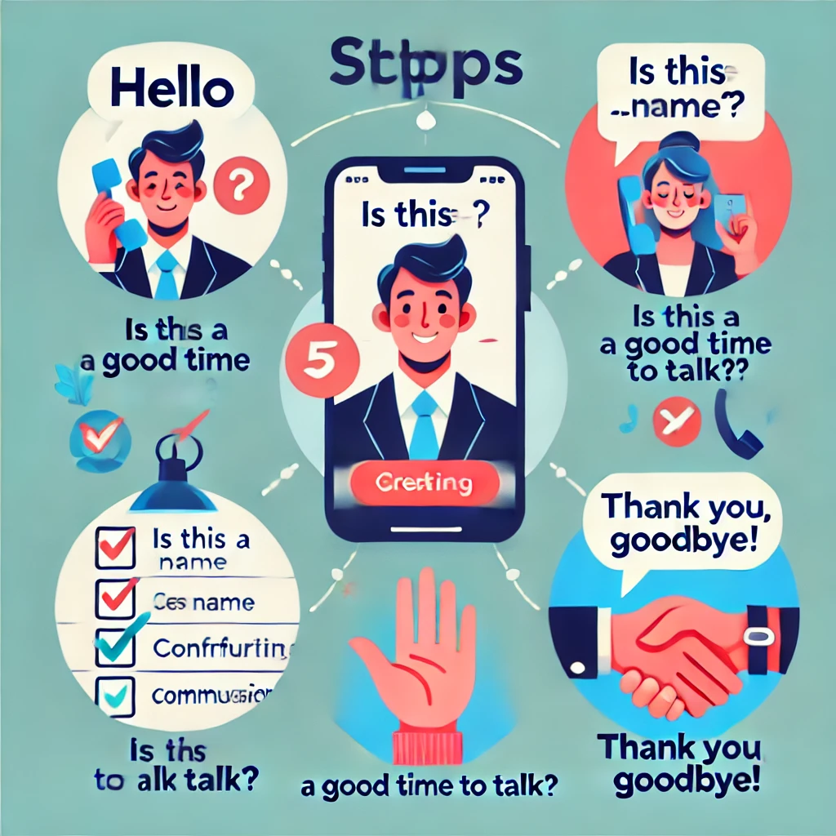
Learning 1 | My takeaways
Mobile Etiquette: A Key Learning Proper mobile etiquette is essential for respectful and effective communication. By following structured guidelines, we can ensure that our interactions are professional and clear.
Key Takeaway:- Adhering to good mobile etiquette fosters professionalism and enhances communication.
Application in the Energy Sector:- In the energy sector, clear communication through proper etiquette is paramount for safety and collaboration.

Slide 5
Learning 2 | My takeaways
Please share (in your own words) details of the learning.
Key learning
Key takeaway
How do I personally see this concept implemented in the Energy sector
[Add a graphic that provides evidence of what you learned]

Slide 6
Learning 3 | My takeaways
Please share (in your own words) details of the learning.
Key learning
Key takeaway
How do I personally see this concept implemented in the Energy sector
[Add a graphic that provides evidence of what you learned]

Slide 7

Relevance of learnings for my organization

Slide 8
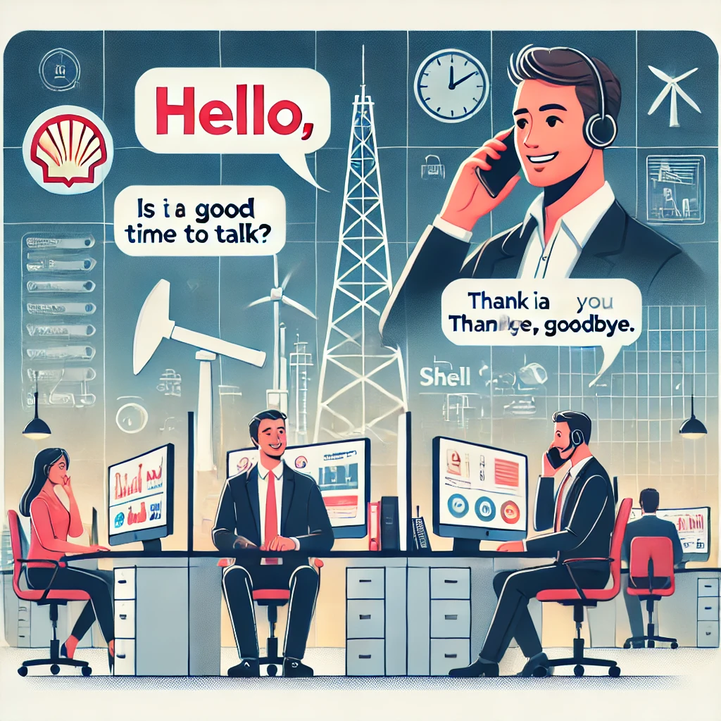
Learning 1 | Relevance for Shell
"Shell effectively teaches mobile etiquette to all new hires. This commitment to proper etiquette is evident in all internal and external interactions. Online meetings, in particular, are conducted with strict adherence to etiquette guidelines.
For Shell, this focus on communication is crucial. As an oil and gas company, maintaining clear and effective communication is essential for ensuring the safety of both employees and customers."

Slide 9
Learning 2 | Relevance for Shell
How I feel Shell implements this learning (in your own words)
How I feel Shell benefits from this learning (in your own words)
[Add a graphic that provides view of how Shell implements this learning]

Slide 10
Learning 3 | Relevance for Shell
How I feel Shell implements this learning (in your own words)
How I feel Shell benefits from this learning (in your own words)
[Add a graphic that provides view of how Shell implements this learning]

Slide 11

Challenges in implementing learning

Slide 12
Challenge faced while implementing Learning 1
As a recent college graduate, I am still adjusting to the formal communication style expected in a professional office environment. It has been challenging for me to adapt my speech patterns.
While the underlying message may remain the same, the manner in which it is conveyed can significantly impact its effectiveness.
[Add a graphic that provides evidence of what you did to overcome this challenge]

Slide 13
Challenge faced while implementing Learning 2
What were the challenges I faced while implementing Learning 2 and my plan to overcome them
GitHub link of your solution/documentation
[Add a graphic that provides evidence of what you did to overcome this challenge]

Slide 14
Challenge faced while implementing Learning 3
What were the challenges I faced while implementing Learning 3 and my plan to overcome them
GitHub link of your solution/documentation
[Add a graphic that provides evidence of what you did to overcome this challenge]

Slide 15

Action Plan

Slide 16
My Action Plan for this Week
Actions
Timeline
Status
Pay close attention to the lessons presented in the training sessions.
Actively engage with colleagues to learn from their experiences and improve my own skills.
Conduct regular self-assessments to identify areas for development.
Learning from the lessons presented continues throughout the three-week training program.
Additionally, the other two areas for development—active engagement with colleagues and self-assessment—are ongoing processes that are essential for professional growth.
I have diligently followed the training lessons and gained valuable knowledge.
My peers are highly skilled and knowledgeable, and I have benefited greatly from interacting with them.

Slide 17

Learning is also Fun!

Slide 18

Learning is also Fun!
We did role play on what are the proper meeting etiquettes that we need to follow.
We also did a group where we made a presentation on a chart paper describing what integrity is.
We also made paper airplanes and learnt that we need to ask questions and get to know the scope of the work we are being assigned and not to blindly assume.

Slide 19

Summary
This week consisted of learning soft skills like call, mail and message etiquetts, how to work in a team, stake holder management, understating of the business analyst role and the agile scrum flow also a lot of fun interactions with my peers.
In the upcoming week we are going to be focusing on technical skills like dbms, scrum and other information which is going to be very important for our work.
Soft skills are going to be an integral part of all our interactions in the workplace. The stakeholder management and the scrum workflows are going to be help full when we are going to be developing a project as part of a team next week.

Slide 20
Thank You

